Slide 1
The Design of Everyday Things
Donald Norman
Lecture by Dr. Tabin Hasan

Slide 2
The Design of Everyday Things
• It examines the effect of poor design and equipment failure on human behavior
• It covers user-centered design, on everyday things and on everyday actions
“Anyone who designs anything to be used by humans -- from physical objects to computer programs to conceptual tools -- must read this book, and it is an equally tremendous read for anyone who has to use anything created by another human. It could forever change how you experience and interact with your physical surroundings, open your eyes to the perversity of bad design and the desirability of good design, and raise your expectations about how things should be designed.”

Slide 3
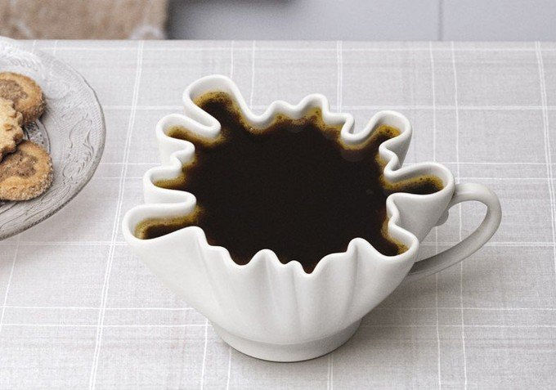
Design of Everyday Things
“I just found a Norman door: It was really difficult to open”
“Science Finds, Industry Applies, Man Conforms”
1933 Chicago World's Fair
More about assimilation

Slide 4
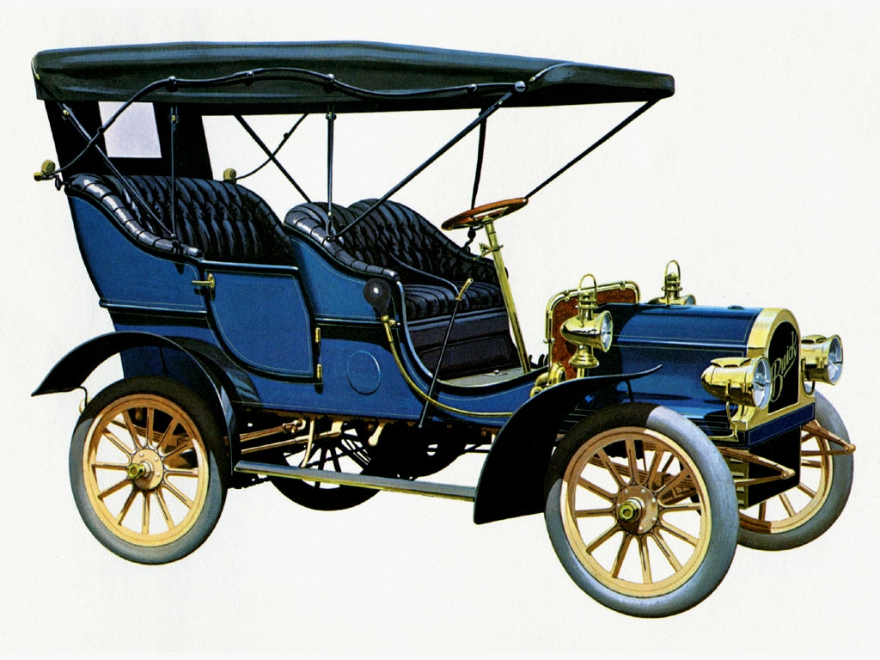

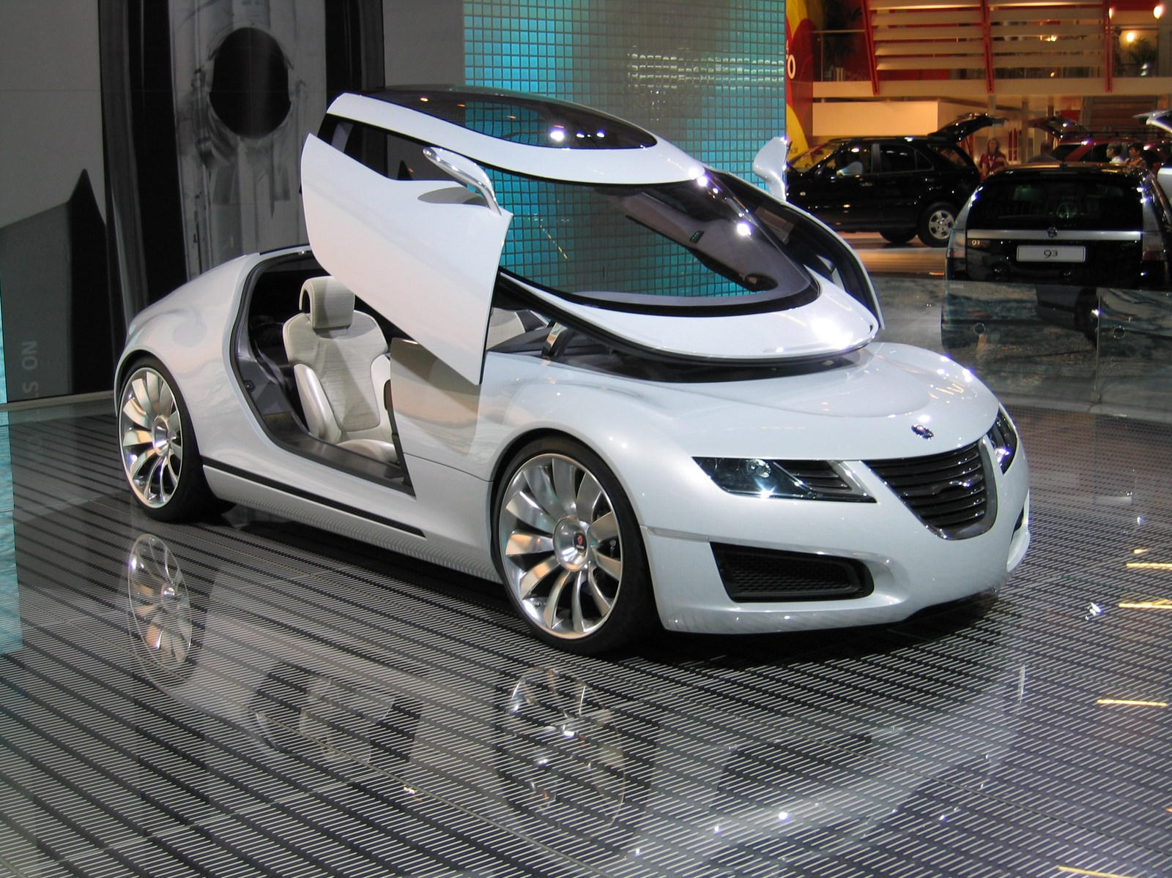
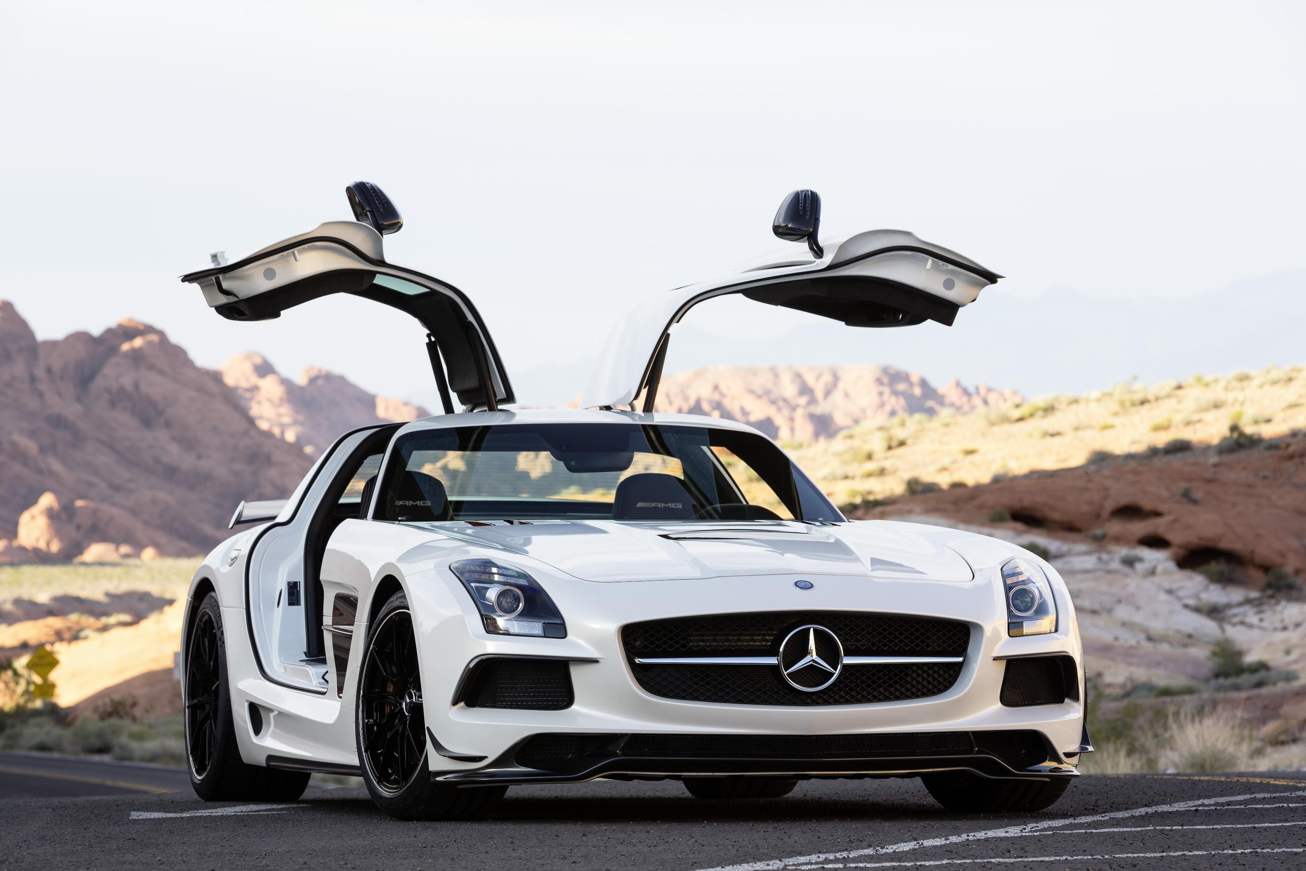
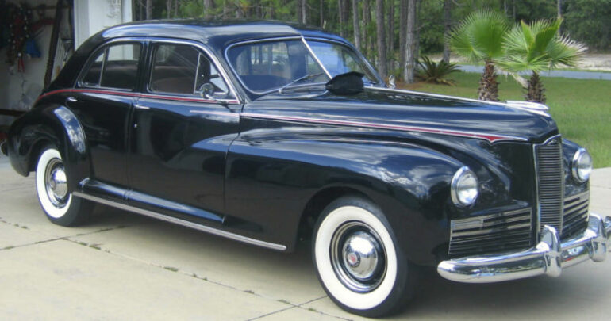
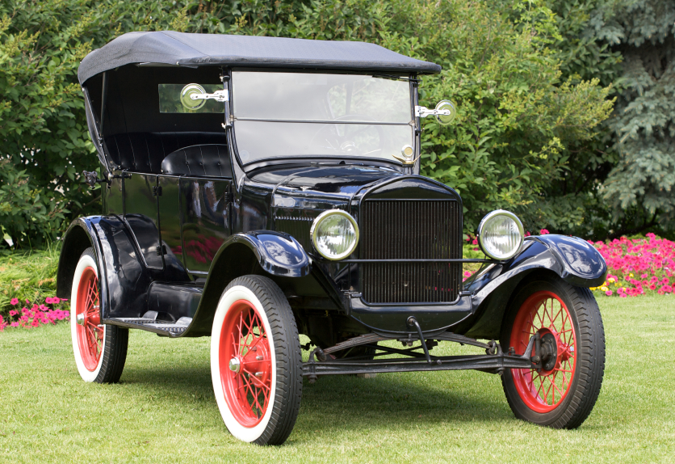
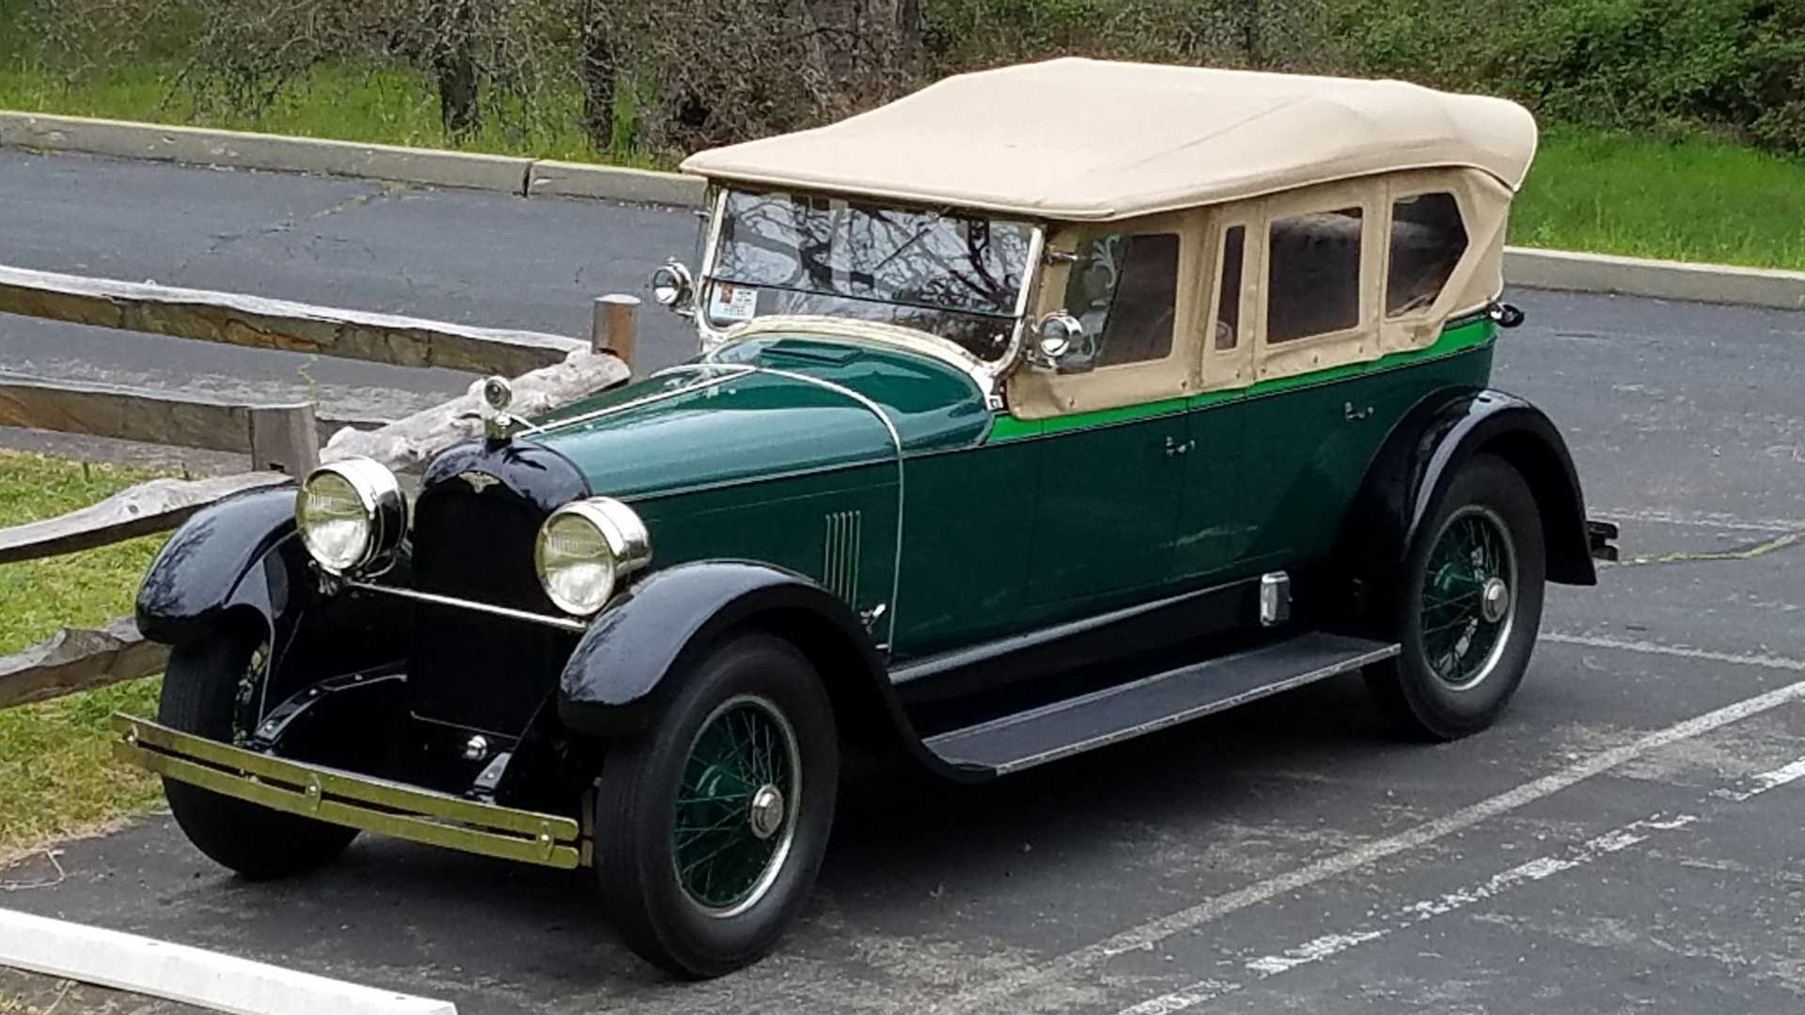
The Cars
You Dream
Bad Fix
Too Expensive
1900s
1910s
1920s
1940s

Slide 5
Look around you...
• Start by looking at Interfaces for
• Doors, Windows
• Stove
• Projectors
• TVs

Slide 6
Affordances
Perceived and actual properties of a thing, primarily those fundamental properties that determine just how the thing could possibly be used
Affordances provide strong clues to the operation of a thing
Knobs are for turning
Slots are for inserting things into
Provide a good conceptual model and make things visible

Slide 7
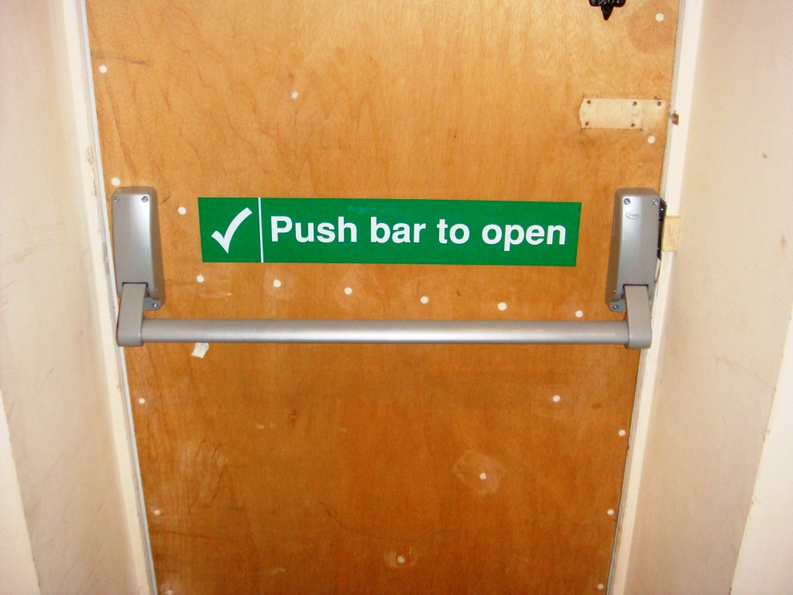
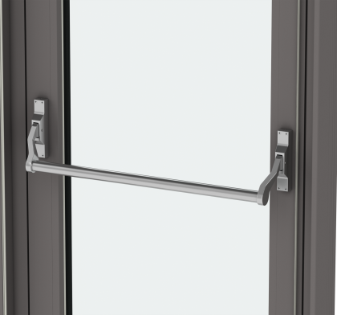
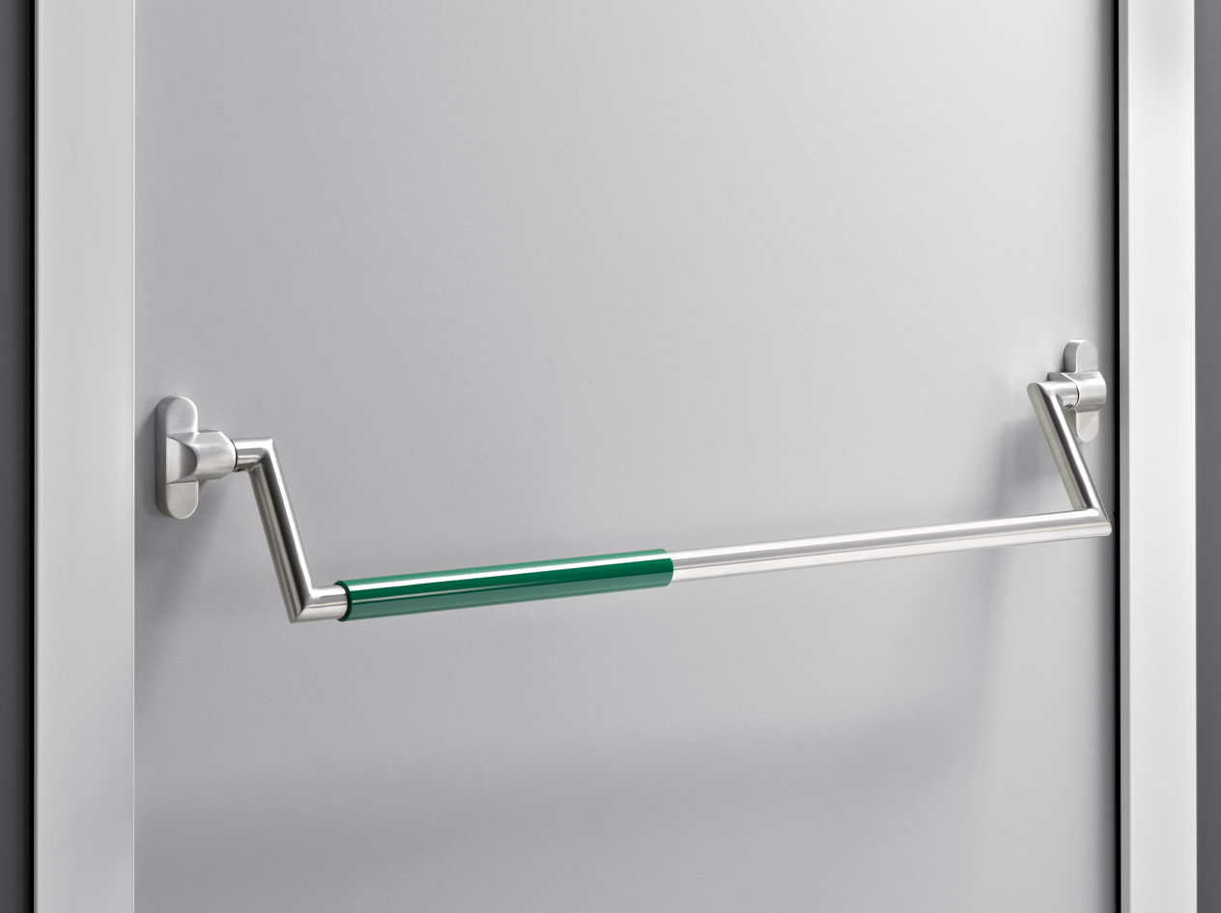
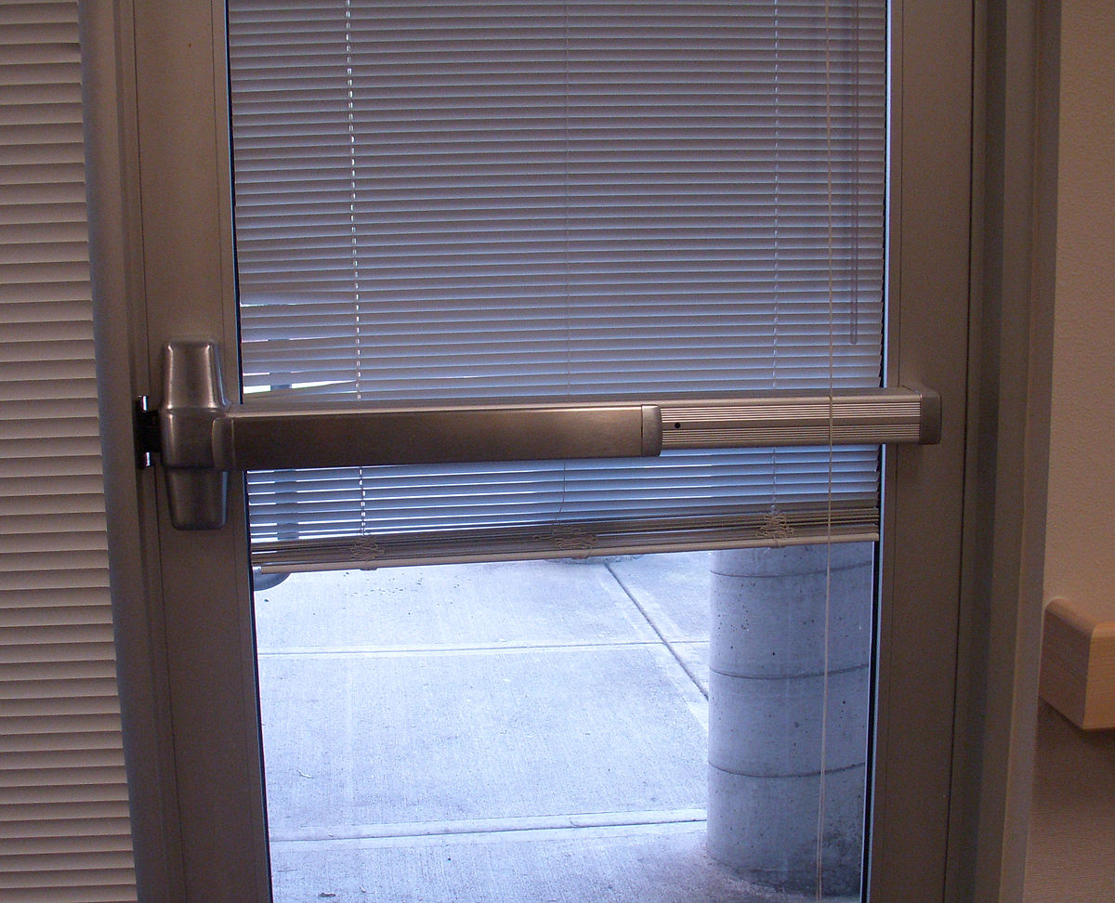
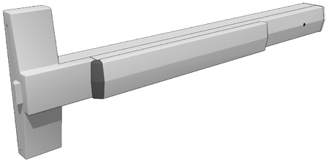
Example: Door
A
Doors in two commercial buildings: Both doors opens with push. Bar A hides the signal and makes it impossible to know on which side to push. Bar B (below) has a flat plate mounted on the side that is to be pushed; this is a naturally interpreted signal. A nice design, no frustration for the user.
B

Slide 8
Two conceptual models
The perception of individual about the world surrounds him/her.
Conceptual models are abstract, psychological representations of how tasks should be carried out. People use conceptual models subconsciously and intuitively as a way of systematizing processes.
The designer's conceptual model
The user's conceptual model

Slide 9
System Image
• The system image is the visible part of a device (including the physical structure, the documentation, instructions, etc)
• The designer only talks to the user through the system image
• If the system image doesn't make the design model clear, then the user will create a
different model through their interaction.

Slide 10
Mental Model
• Conceptual model of the way something works
• Often constructed from fragmentary evidence

Slide 11
Example: Thermostat
• Will a room or oven heat (or cool) faster if the thermostat is turned all the way to the maximum setting?
• Two 'folk' theories of thermostats
• timer theory - thermostat controls the relative proportion of time that the device stays on
• valve theory - thermostat controls how much heat (cold) comes out of the device

Slide 12
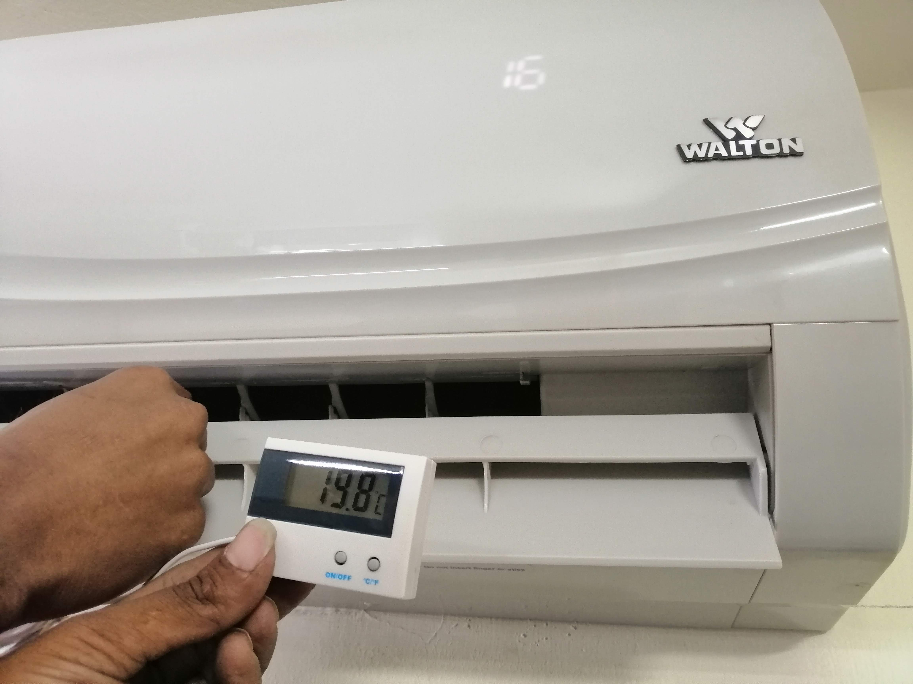
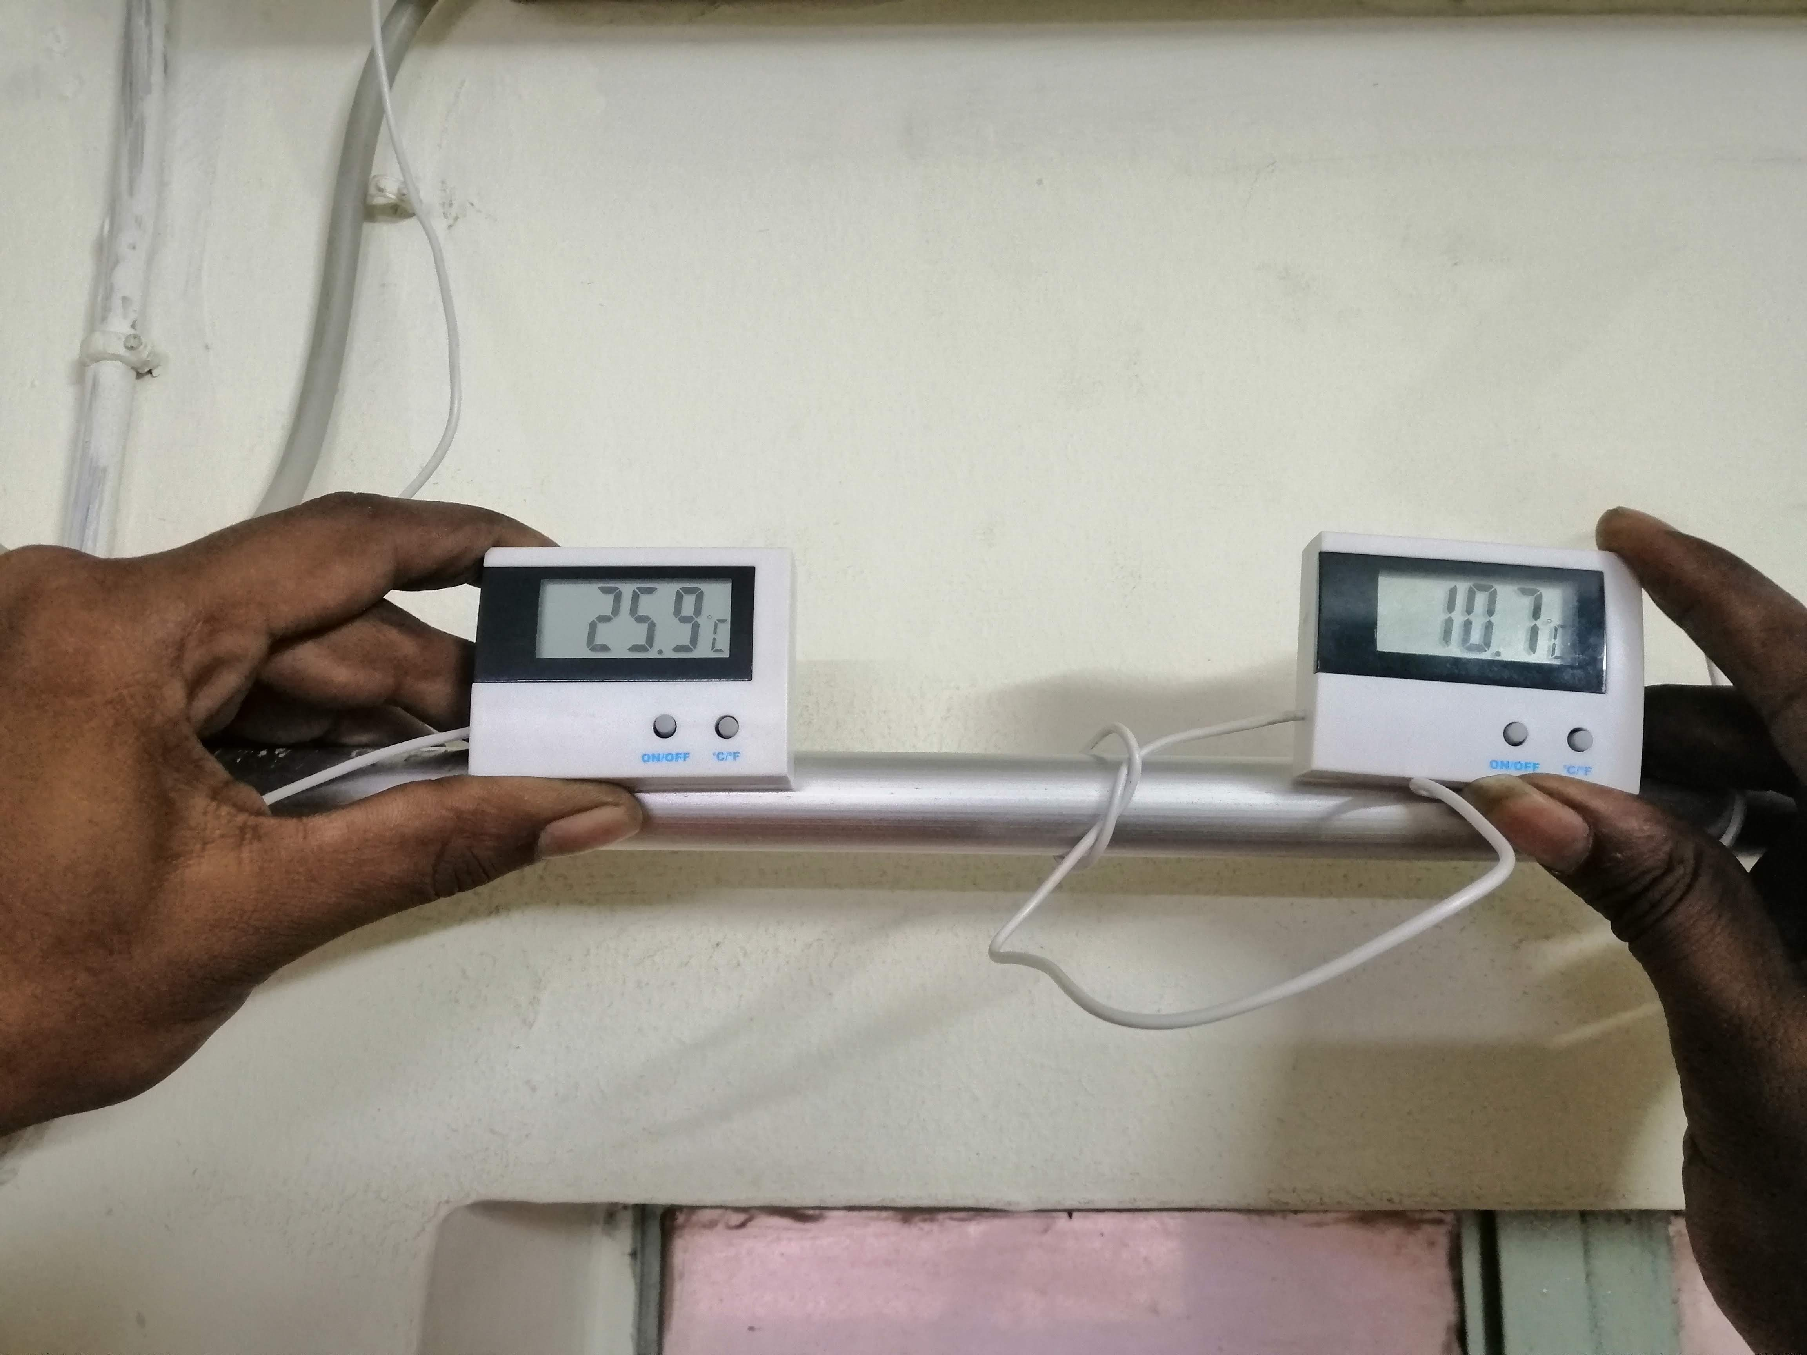
Thermostat
• Both are wrong
• Thermostat is an on/off switch
• Fully on or fully off - no in between
• Design gives no hint to the actual model
• User's form their own theories

Slide 13
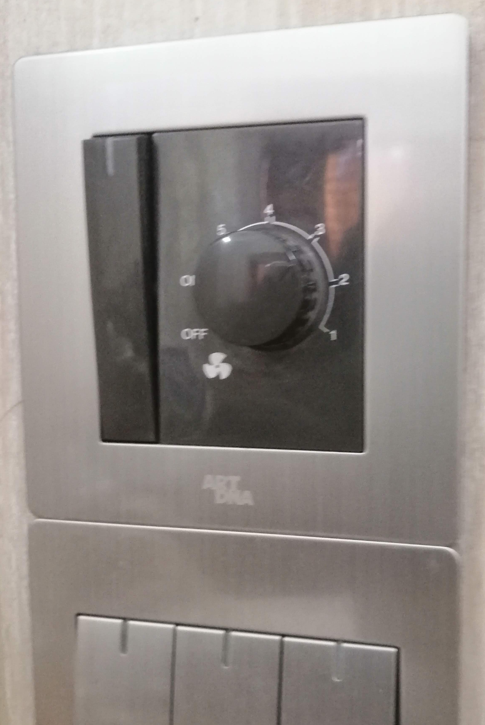
Mapping
• Relationship between controls and their affects
• Want the mapping to be 'natural'
• taking advantage of physical analogies and cultural standards.
• Steering wheel
• Digital alarm clocks
• Stove burners
• Light switches

Slide 14
Automobile
• Why is the basic automobile easy to figure out?
Things are visible
Good mappings between controls and things controlled
Single controls have single functions
at least for driving - the radio is another story
Good feedback - immediate and obvious effect

Slide 15
Connector

Slide 16
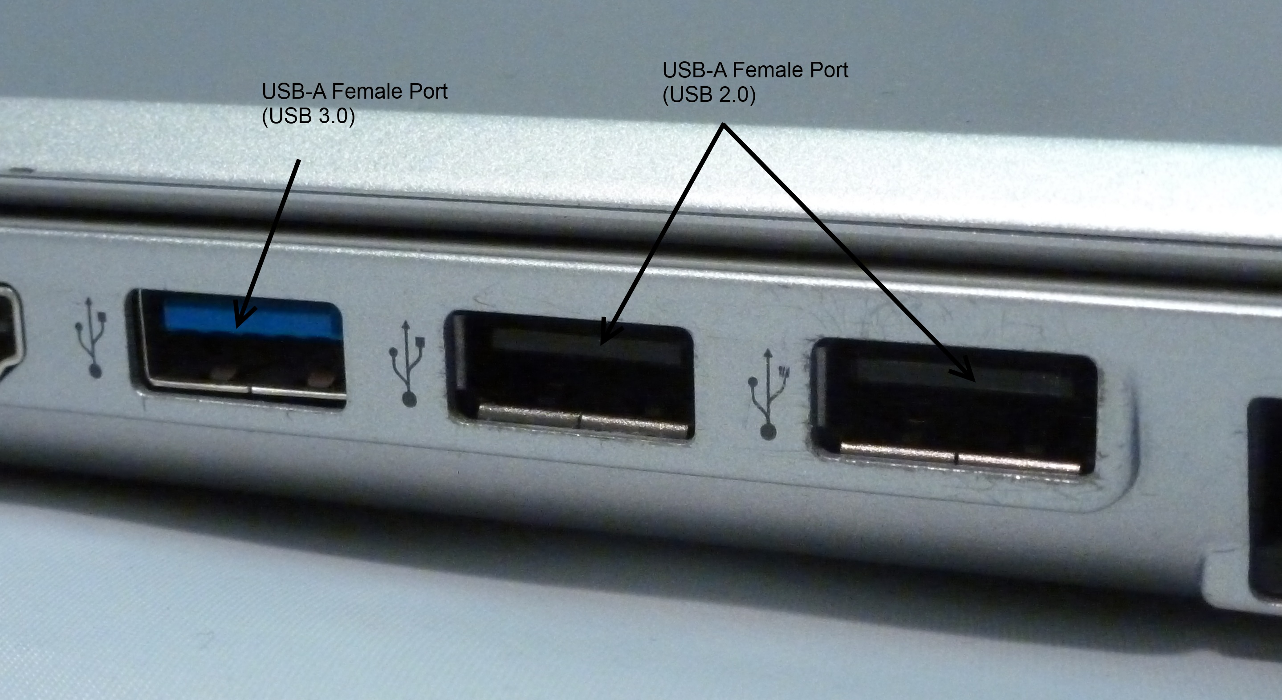
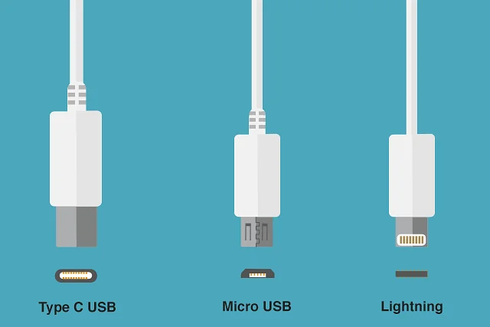
Home Examples
No writeups on the appliances
Trial and error
USB ports
Light switches

Slide 17
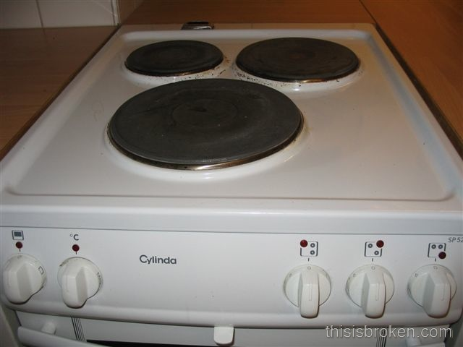
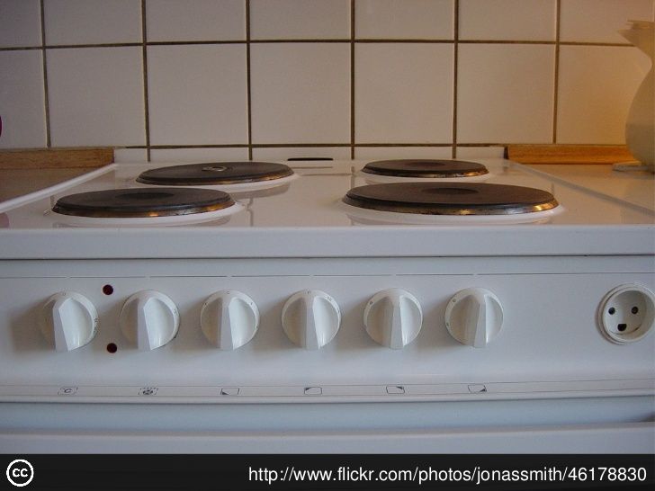
Home Examples

Slide 18
Home Examples
light switch for fan/lights

Slide 19
Home Examples
Porch lights
More examples - http://www.baddesigns.com

Slide 20
Human Error
Two fundamental categories are
Slips and
mistakes.
Slips result from automatic behavior, when subconscious actions that are intended to satisfy our goals get waylaid en route. Slips are almost always small things: a misplaced action, the wrong thing moved, a desired action undone. Moreover, they are relatively easy to discover by simple observation and monitoring.
Mistakes result from conscious deliberations. Form the wrong goal, and you've made a mistake. Mistakes can be major events, and they are difficult or even impossible to detect—after all, the action performed is appropriate for the goal.

Slide 21
Types of Slips
CAPTURE ERROR: I was using a copying machine, and I was counting the pages. 1 found myself counting '1, 2, 3, 4, 5, 6, 7, 8, 9, 10, Jack, Queen, King.’ I have been playing cards recently.
DESCRIPTION ERRORS: A former student reported that one day he came home from jogging, took off his sweaty shirt, and rolled it up in a ball, intending to throw it in the laundry basket. Instead he threw it in the toilet. (It wasn't poor aim: the laundry basket and toilet were in different rooms.)
DATA-DRIVEN ERRORS: I was assigning a visitor a room to use. I decided to call the department secretary to tell her the room number. I used the telephone in the alcove outside the room, with the room number in sight. Instead of dialing the secretary's phone number—which I use frequently and know very well—I dialed the room number.

Slide 22
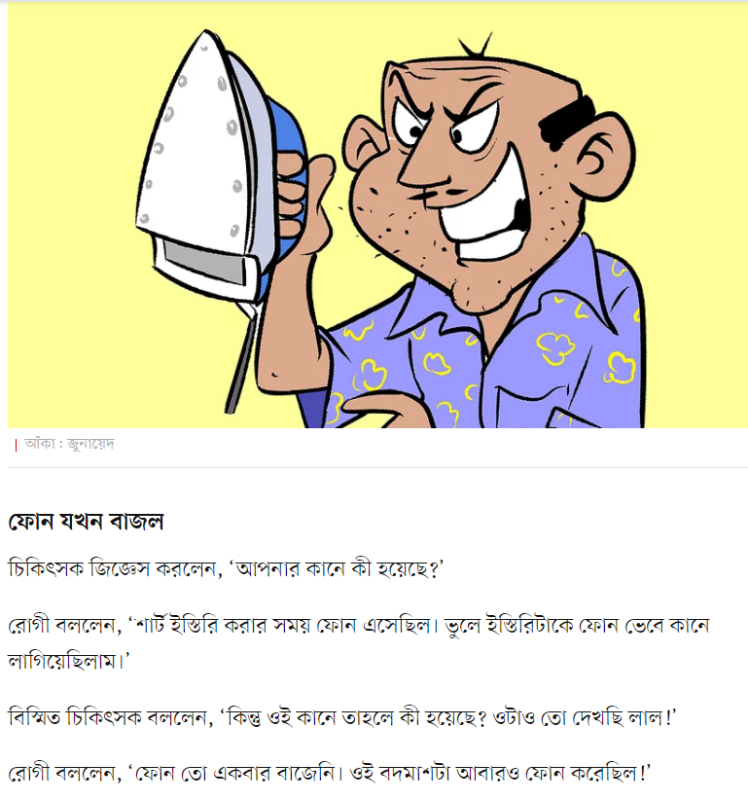
Types of Slips
ASSOCIATIVE ACTIVATION ERRORS: My office phone rang. I picked up the receiver and shouted repeatedly 'Come in' at it. (Sigmund Freud)
LOSS-OF-ACTIVATION ERRORS: "I have to go to the bedroom before I start working in the dining room. I start going there and realize as I am walking that I have no idea why I am going there. Knowing myself, I keep going, hoping that something in the bedroom will remind me. . . . I get there but still cannot recall what I wanted. . . so I go back to the dining room. There I realize that my glasses are dirty. With great relief I go back to the bedroom, get my handkerchief, and wipe my glasses clean."

Slide 23
Types of Slips
MODE ERRORS: I had just completed a long run from my university to my home in what I was convinced would be record time. It was dark when I got home, so I could not read the time on my stopwatch. As I walked up and down the street in front of my home, cooling off, I got more and more anxious to see how fast I had run. I then remembered that my watch had a built-in light, operated by the upper right-hand button. Elated, I depressed the button to illuminate the reading, only to read a time of zero seconds. I had forgotten that in stopwatch mode, the same button [that in the normal, time-reading mode would have turned on a light] cleared the time and reset the stopwatch.

Slide 24
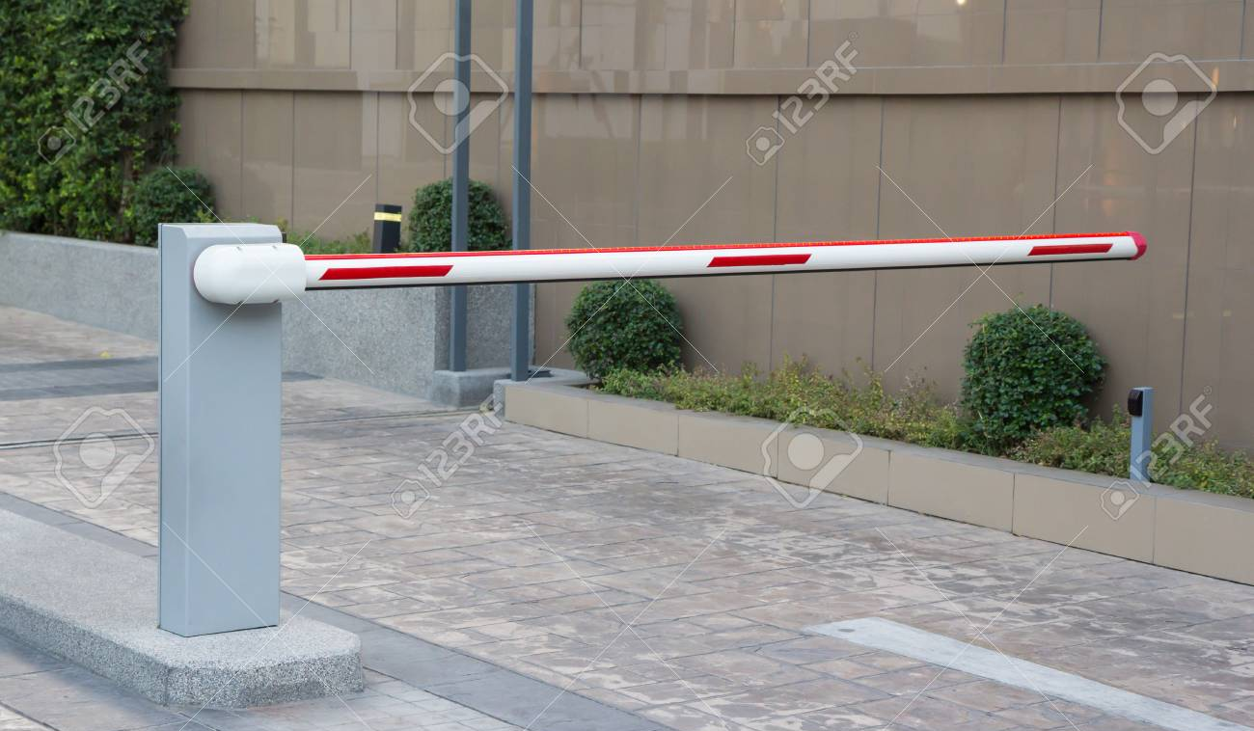
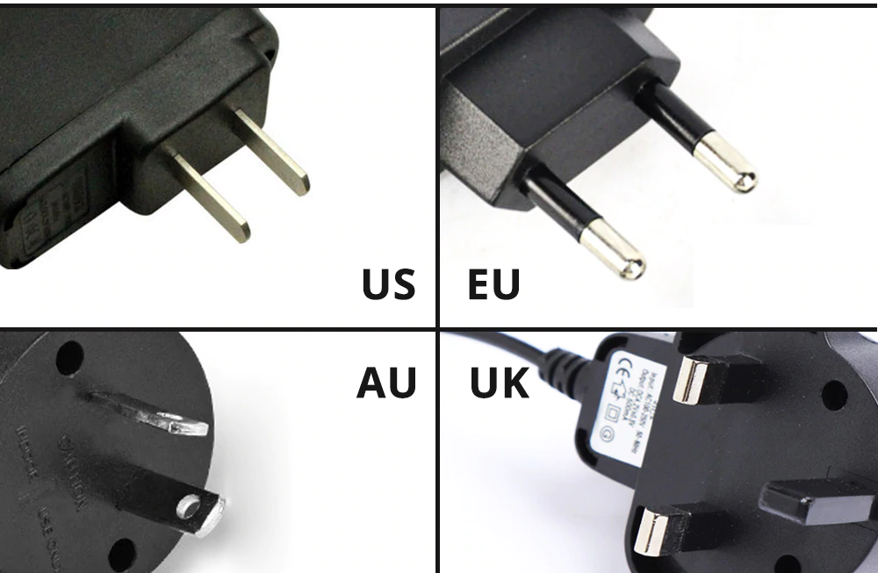
Constraints
• Physical
• Semantic
• Logical
• Cultural

Slide 25
Constraints – First line of Defense against human error
Physical Constraint The use of physical constraints limit the actions that can be taken in the use of a product. Physical constraints can be perceived directly just by looking at the object itself without prior learning. The physical structure of a product is heavily considered to determine the possible actions that can be performed. Physical constraint only allows functions to be carried out by a product when the action that the user takes is correct. If the action that the user takes is incorrect, the product will not carryout the function in which it was designed for.

Slide 26
Constraints
Semantic Constraint The use of semantic constraint depends heavily on the user’s knowledge about the condition where a product is used and how it relates to the physical world. Indeed, different products are being used in different conditions to carryout their functions. Users have to depend on their tacit knowledge, which is a type of knowledge that people build up based on previous experience, to determine the actions needed to be performed under a certain condition to get functions from a product. For example, the function of a car is to transport people from a point to another. The car must be running on the road and the driver must be seated facing the front in order to see the road.

Slide 27
Constraints
Cultural Constraint The use of cultural constraint depends heavily on the user's culture and belief background. Different countries have different cultures and beliefs. Some cultures limit certain actions and behaviors to be performed under a certain condition to be considered as appropriate. For example, the color of red is universally perceived as the meaning to stop. Therefore, traffic light systems around the world, regardless of the culture aspect, only use the red light as a signal to stop the traffic. The red light is also placed at the back of the car to signal that the car is coming to a stop.

Slide 28
Constraints
Logical Constraint The use of logical constraint is closely related to natural mapping. Natural mapping depends on logical constraints to carry out its function. For example, the action to move a control button upwards means to increase a result. In the case of a remote control, you’ll press the button that indicates upward if you want to increase the volume and press the button that indicates downward if you want to decrease the volume.

Slide 29
Example: Toy

Slide 30
Forcing function
In some cars you need to use the keys to lock the door
Can’t lock keys inside
• Up until the late 1940s it was possible to try and
start car without the key in the ignition
• The key was put in the dashboard to unlock
the car and then you pressed the starter
button
• Now you insert the key and turn it to start the
car
• Separating these functions is making a comeback, since you can now remotely start some cars without having the key in the ignition

Slide 31
Forcing function
• A 25-year-old man was killed in a freak accident in a plastic factory in India after he was swallowed up by a large bladed machine which he had been cleaning.
The horrific incident, caught on CCTV, happened at the factory located in Noida, a satellite city of Delhi, on Thursday morning 27 Sep, 2018.
According to police, the man, identified only as Wajid, was cleaning the machine when someone switched it on and he was sucked in.

Slide 32
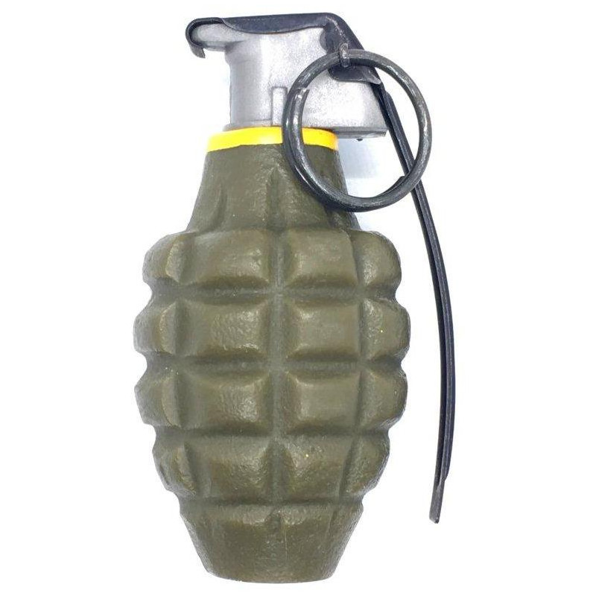
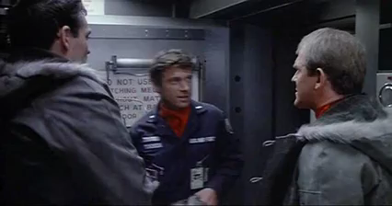
Forcing function - Second line of Defense against human error
• Interlocks - prevent accidental use of a device
• pin on fire extinguisher or hand • force operations to take place in proper sequence
grenade
• Lockins - keeps operation active preventing someone from
permanently stopping it
• if you ask a word processor to quit it should ask you if you
want to save the modified file you have been working on or
discard the changes
• Lockouts - prevents an event from occurring
• in case of fire, can't go below the first floor on stairs
"WarGames" (1983)

Slide 33
Gulf of Execution
• How well does the system allow someone to do their intended actions directly
• Do the affordances provided by the system match the actions intended by the person
• Bad if not clear what actions need to be done to accomplish the intention

Slide 34
Gulf of Evaluation
• How well does the system provide a visible state that can be directly perceived and that is interpretable in terms of the intentions and expectations of the user.
• How much effort user must exert to interpret the state of the system and determine how well the expectations and intentions have been met.

Slide 35
7 Stages of Action
• Forming the goal - state to be achieved (often ill-formed)
• Forming the intention - goal translated into intention to perform some action
• Specifying an action - translate intention into set of internal commands
• Executing the action
• Perceiving the state of the world
• Interpreting the state of the world
• Evaluating the outcome

Slide 36
Example
• You reading a book at dusk and its getting dark
• Goal
• get more light
• Forming intention
• push the switch on the lamp
• Specifying action
• how to move body

Slide 37
7 Stages as Design Aid
• How easily can a person
• Determine the function of the device
• Tell what actions are possible
• Determine mapping from intention to physical movement
• Perform the action
• Tell if system is in desired state
• Determine mapping from system state to interpretation
• Tell what state system is in

Slide 38
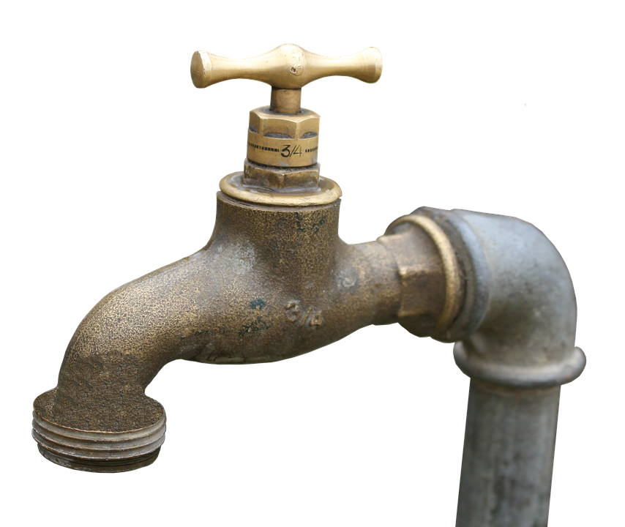
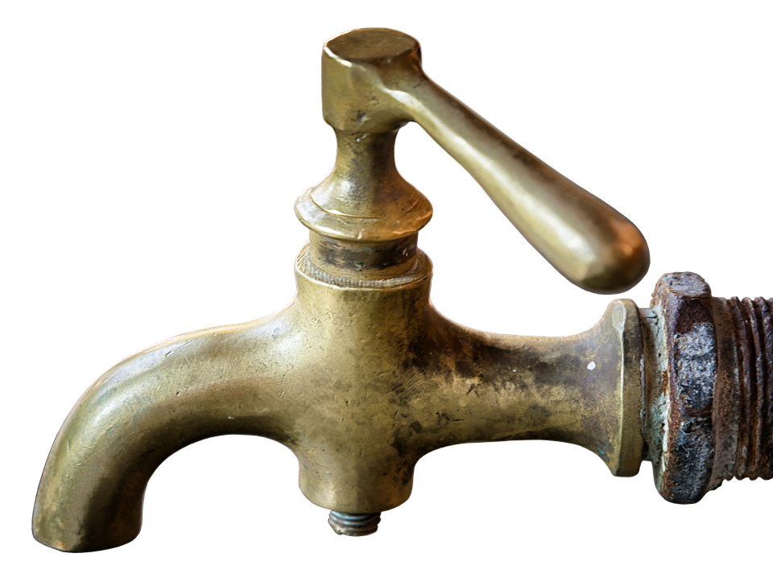
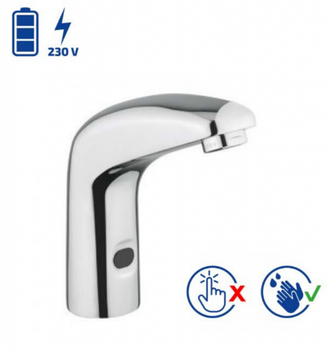
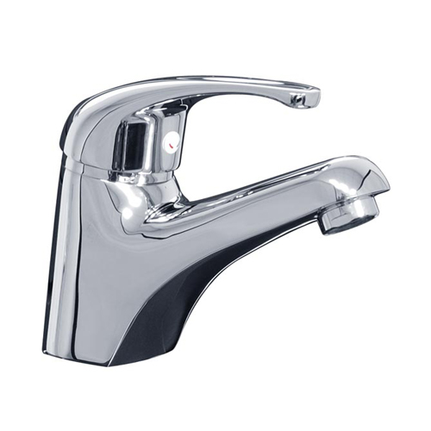
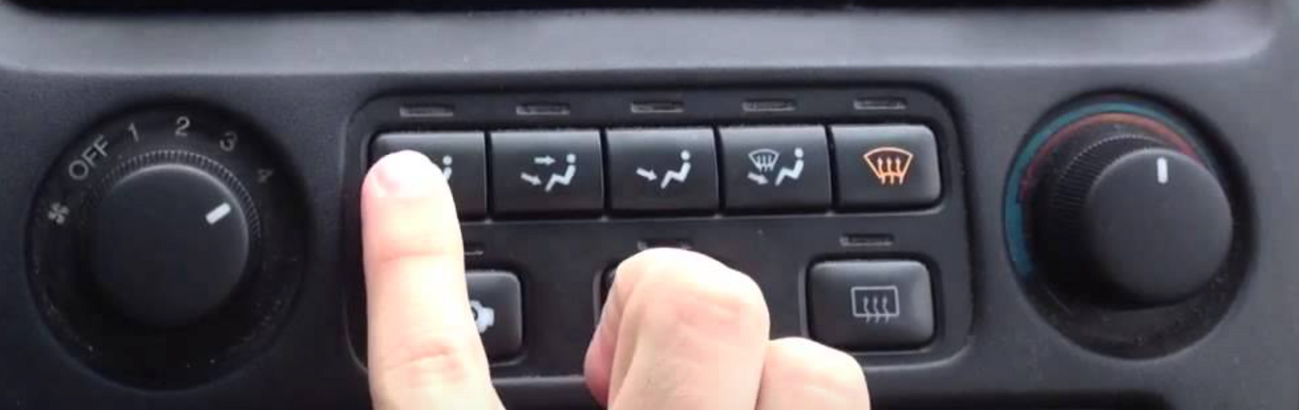
Examples
• Faucets
• Car air conditioner
• Think about these in terms of
• Visibility
• Mapping
• Feedback
• 7 Stages of Action

Slide 39
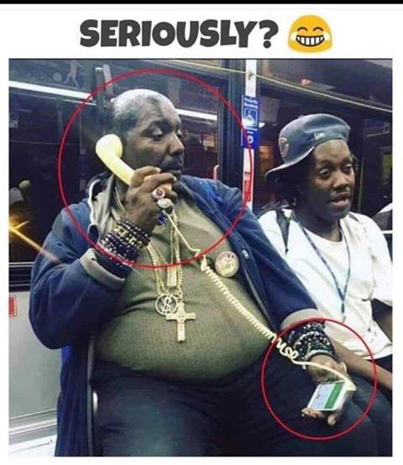

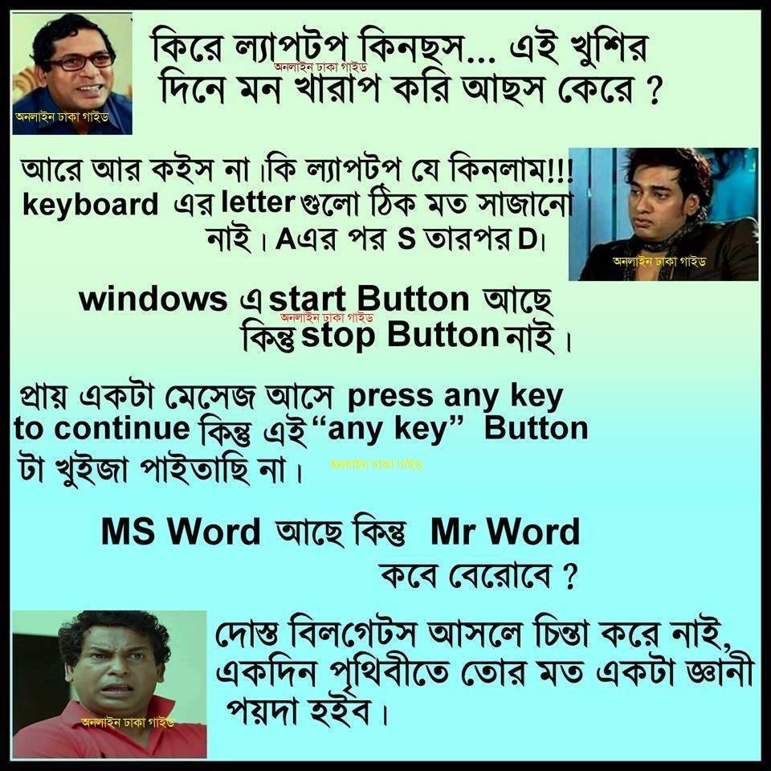

Slide 40
Designing for Error
• Visibility - User can tell the state of the device and the alternatives for action
• Good conceptual model - User given consistent in presentation of operations and results
• Good Mappings - easy to determine relationships between actions and results, controls and their effects, system state and what's visible
• Feedback - User receives full and continuous feedback

Slide 41
Assignment
Discover three design errors in terms of affordance, visibility, feedback, mappings, constraints, forcing function in your Teams application.
Discover all types of slips in your everyday actions. One for each type.
Copy/paste will seriously injure your grade!!!
Submission deadline on Teams

